Slide 1


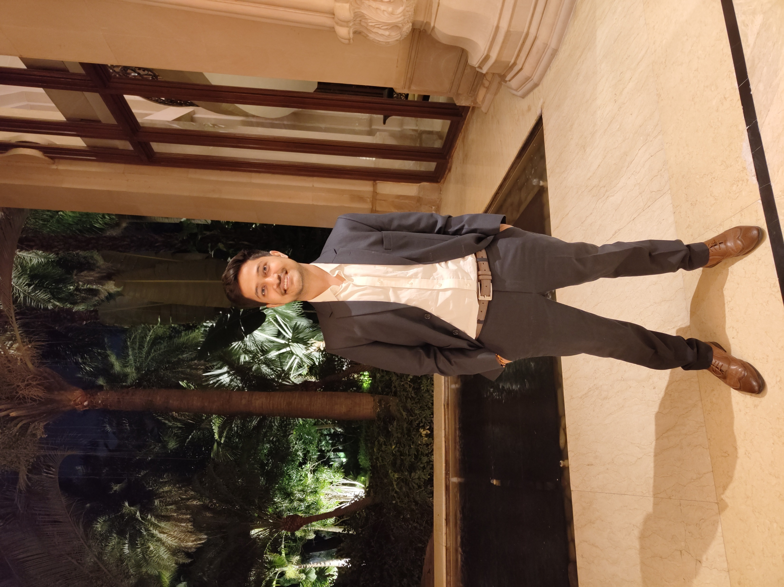

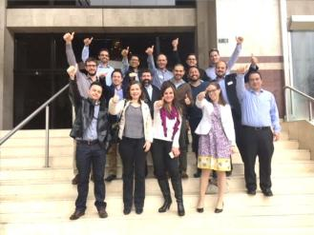
EcoDeliver : Sustainably rethinking last mile delivery
Team HelLuminati | IIM Lucknow
Member | Kripi Badonia | Kritika Prakash | Shivam Pathak | Manav Sehgal
Feathers​ pre-IIML | DTU, DCE BCG | SNU American Express | MIT, Manipal JLL​ | Hansraj, DU Bain
Summers @ IIML​ | BCG | Auctus Advisors | ​Accenture Strategy | Yet to conquer!
MBA Year 1 standouts | Consulting & Strategy Club, Abhivyakti | Manfest-Varchasva | Manfest-Varchasva | Yet to conquer!

Slide 2
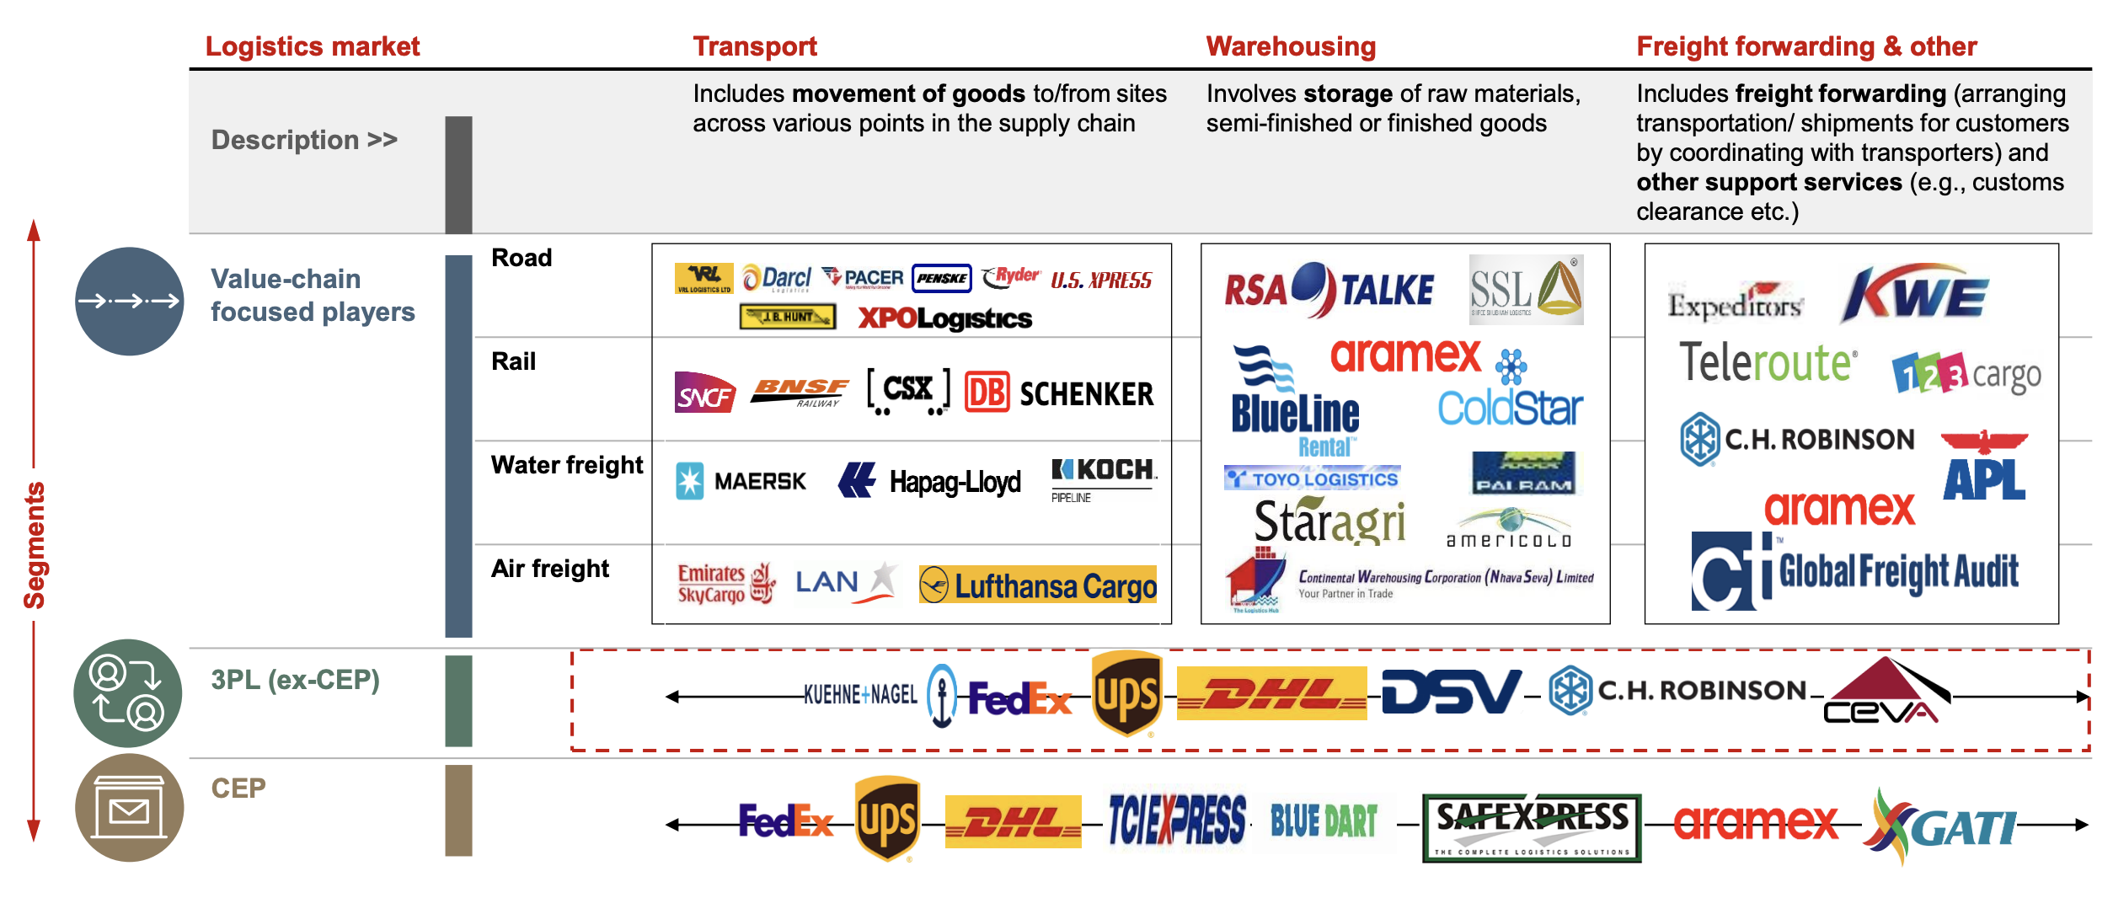
EcoDeliver needs to rethink supply chain architecture to solve for key challenges of LMD and changing consumer preferences
E-retail to grow 4x by 2025¹..
..but supply remains fragmented..
...as does Indian regional demand⁴
How-To-Win: EcoDeliver’s disruption strategy
Indian online retail market ($Bn)
Long tail of mid-major players that cater to regional markets
Area (km²)
vs 2020F Consumption ($B)
Rural
Mitigating high process costs by fleet optimization (outsource/P2P)
1
CAGR: 30%
Online shoppers growing from 100 Mn to
300-350Mn
Market Share¹
Tier 2+
Decrease conversion
Attrition
Customer
Cost
Big & bulky focus
Top 50
cities
Customer support; no SLA’s
Parcel Focus, 5%
Driver
Fuel
Maintenance
Deep dive ahead
2
Turning sustainable via operational excellence
Significant shift in consumer preferences has also been observed in the industry leading to market gaps⁵
Focus areas
43%
62%
37%
Sustainability
Tech-driven
City WH
Green Packing
Optimal linehaul
consumers are more likely to choose retailers that offer more sustainable delivery options
customers were okay with waiting reasonably longer for green packaging
consumers rated a social media enabled differentiated customer service offering the highest
Flexible
Transport
Dynamic Route
Green Fleet
Significant scope to play, grow & disrupt
Distributor
Re-optimisation
Deep dive ahead
Various delivery models have evolved….
…but core challenges are yet to be addressed
Customer
P2P Ecosystem
Highest Cost
LMD accounts for 41% of total SC costs²
Scope for next phase
Unknown demand
LMD Forecasts have ~60% accuracy
3
Becoming a market shaping force
High expectations
High qual. service reliability & redressal
1
Enforce standards battle
Establish virtuous cycle
Break performance barriers
Reinforce market shaping
Traffic Congestion
Core contributor; route optimality red.
4
Leadership
Playbook
2
Emissions
~40% of SC emissions during last mile³
3
1. Statista 2. Bain Analysis. 3. iPAC Analysis 4. Bain Analysis 5. Press Analysis
Industry Analysis
Total SC Reinvention
Transportation
Transportation
Distribution
Distribution
Redefining P2P Ecosystem
Win Win Win

Slide 3



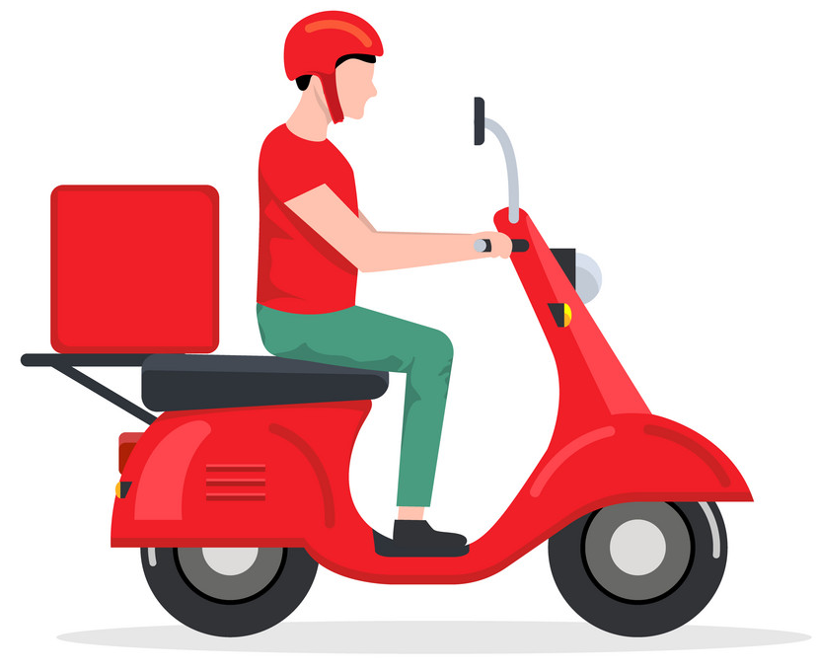
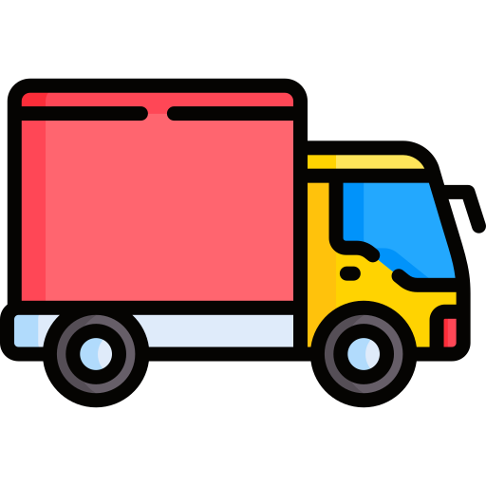




Augmentation of physical assets across value chain with 360º technology stack will lead to LMD reinvention
Physical Layer
Technology Stack - Integration with IT Systems
City WH
Control Tower
Map up & downstream operational processes against data touch points
Control Tower integration: Provides live updates on linehaul progress to control tower & alerts depots of impending arrival
City WH
Inventory
arrives
Live
updates
Optimized packing: Auto-generated manifest to order freight loading
Driver app for delivery planning: Detailed optimized route, live driver monitoring & performance tracking
Process
Order management system for live pickup requests
Linehaul optimisation: Dynamic optimisation of linehaul volumes into trucks and truck packing plan
A
B
C
Front-end UI: Auto pre-delivery alert & e-record of delivery (customer selects delivery window)
Allocation
Pre-determined rosters and routes can link in with multiple systems
Integrating with this system is key to achieve full dynamic routing
Transportation
Process
Present Model
3P/OEM Collaborations
P2P Ecosystem Network
Live re-optimisation: Auto assignment of new pickups to optimal driver & real time re-optimisation of driver routes
Dynamic routing: Based on variable demand, can integrate to sortation system
Fulfilment Centre
Distribution
Tier 1: Metro Station, Residential & Office Spaces
Tier 2: Kirana Stores
Process
Tracking Drivers: Compliance measurement and feedback to drivers is key for adoption
Measure number of users using the system as well as accuracy if applicable
End Customer
Customer ID codes & cleansed address reference lists
Up or downstream customer portals
Customer
Industry Benchmark
Carbon Emission Reduction
35%
Fuel Efficiency
23%
Waste Reduction
55%
Social Impact
5-7%
Employee Well-Being
1-3%
Industry Analysis
Total SC Reinvention
Transportation
Distribution
Redefining P2P Ecosystem
Win Win Win

Slide 4
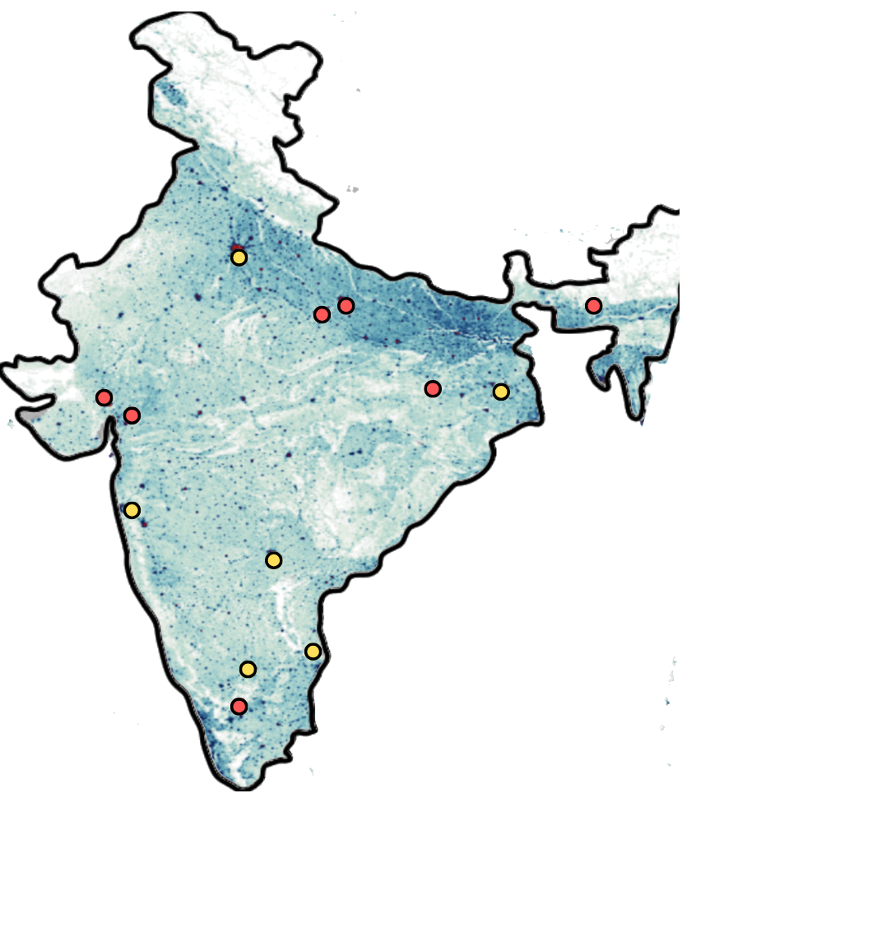





Industry will move towards green fleet optimization across LMD models to ensure compliance with ESG std.
Eco-conscious Route Optimization
Drop Location Identification Input: Population & Order density, Cost-Benefit analysis
Route Input: Fleet, Distribution Nodes, Historical Data, Potential Routes
Green Input: Weather & Traffic Patterns, Customer Requests, Geographic Obstacles, Customer Requests, Accidental Damage
Optimization Capabilities
Last Mile Delivery system for City X
Route Planning to sequence driver routes based on real-world operational constraints
A
B
C
Fuel-Based, Own Fleet
Outsourced Fleet
P2P Network
Freight Allocation to match live volume info with fleet capacity and constraints
2-wheeler riders
Mini Trucks
2-wheeler riders
Mini Trucks
General P2P
Personal P2P
Fleet Management for real-time fleet tracking & driver performance tracking
Challenges
Possible Solutions
Peer picks from CDC or Drop Site & drops at semi-dark store
Trusted peer picks from CDC/Drop site & drops at home
Field Force Optimization for optimized sales force – customer allocation
Multiple same-day deliveries to single location by one company
Order Consolidation to reduce trips, fuel consumed & emissions
3D Packing Optimization with optimised 3D packing algorithm
Less than Truck Load leading to inefficient utilization of capabilities
Co-Loading to combine load of different co. by opening network
Challenge: Lack of control & trust impacts cost via lost/damaged parcel
Legends
Multiple stops at various points due to fragmented distribution
P2P Network to reduce stops & offload fragmented distribution
Possible Solutions: Incremental loading, commission & badges
Tier 1 cities
Tier 2 cities
Current Position
Future Position: Asset Light & Sustainable
EV Fleet
Social Network of P2P
Industry
Leaders
Method: Battery swapping & charging of fleet at warehouse, powered by solar panels
Customer creates own P2P network with trusted folks
Major E-Commerce hubs in India
75% own + 25% outsourced by ‘24
50% own + 50% (OS +P2P) by ‘27
30% own + 70% (OS +P2P) by ‘30
Industry Analysis
Total SC Reinvention
Transportation
Transportation
Distribution
Distribution
Redefining P2P Ecosystem
Win Win Win

Slide 5





Customers will move towards sustainable deliveries provided logistics company develop incentives about ESG
Industry/ category | Speed and reliability) | Flexibility | Shipment Integrity | Customer service | Tech enabled offerings
Must have | Premium offering, with better transit time | Flexible pick-up scheduling | Low damages & pilferage/claims | 24/7 support, KAMs for large customers | Milestone tracking
Differentiation | 95% on-time SLA with money back guarantee; same day delivery | Flexibility to cater to Peak Demand | Less than industry claims frequency %age | Differentiated customer service offering – social media enabled | API/ERP Integration, Return request – QC/Scanning
Distribution Model after reaching Fulfilment Centers
Customer Satisfaction
Key Challenges of LMD
Key IT Solutions
Customer journey before receiving the product
Customer needs to give the following info one-day prior to scheduled delivery. Customer is shown a notification/prompt for the same.
Address Verification
Front-& back-end address verification
Preferred time
Preferred drop location: Home or Fulfilment Centre
Poor driver assignment & tracking driver behaviour
Hyper-scaling driver assignment, including actual drive time & vehicle type & capacity
Negative/positive ESG points for choosing delivery to home/fulfilment centre
Ability to change location till it’s dispatched from WH
Real time tracking of both side to ensure lower package miss/return rate
High distance travelled by a delivery person
Route optimization for single orders through AI algorithms
Customer Expectations
Visibility
Reliability
Timeliness
Limited Customer Transparency
Introduction of new peer-to-peer delivery of product
Customer Satisfaction
Using anticipatory shipping via social listening
Delivery companies use customer and geolocation data to ensure a package is delivered the first time. By using geolocation to see that a customer isn’t home, the delivery company can automatically leave the package in an alternative location per the recipient’s known preference.
Lack of delivery partner repeatability, hence tacit knowledge is lost
Implementing our peer-to-peer delivery system
Industry Analysis
Total SC Reinvention
Transportation
Transportation
Distribution
Distribution
Redefining P2P Ecosystem
Win Win Win

Slide 6
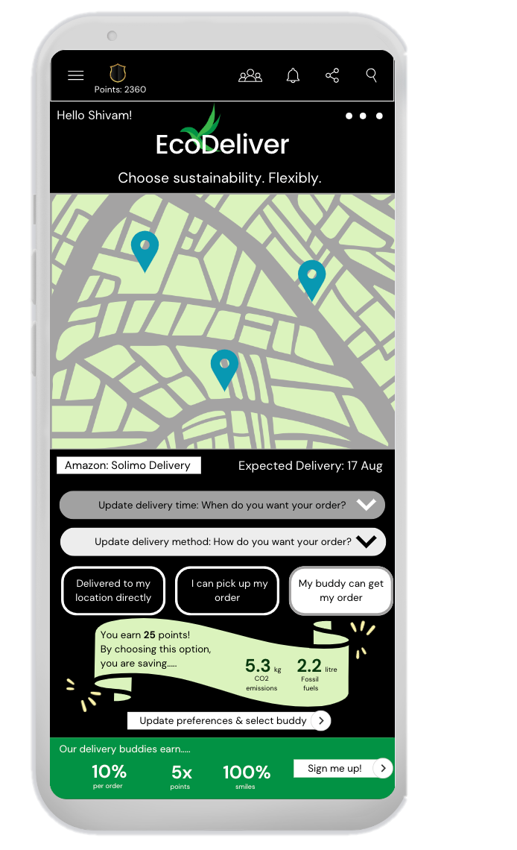



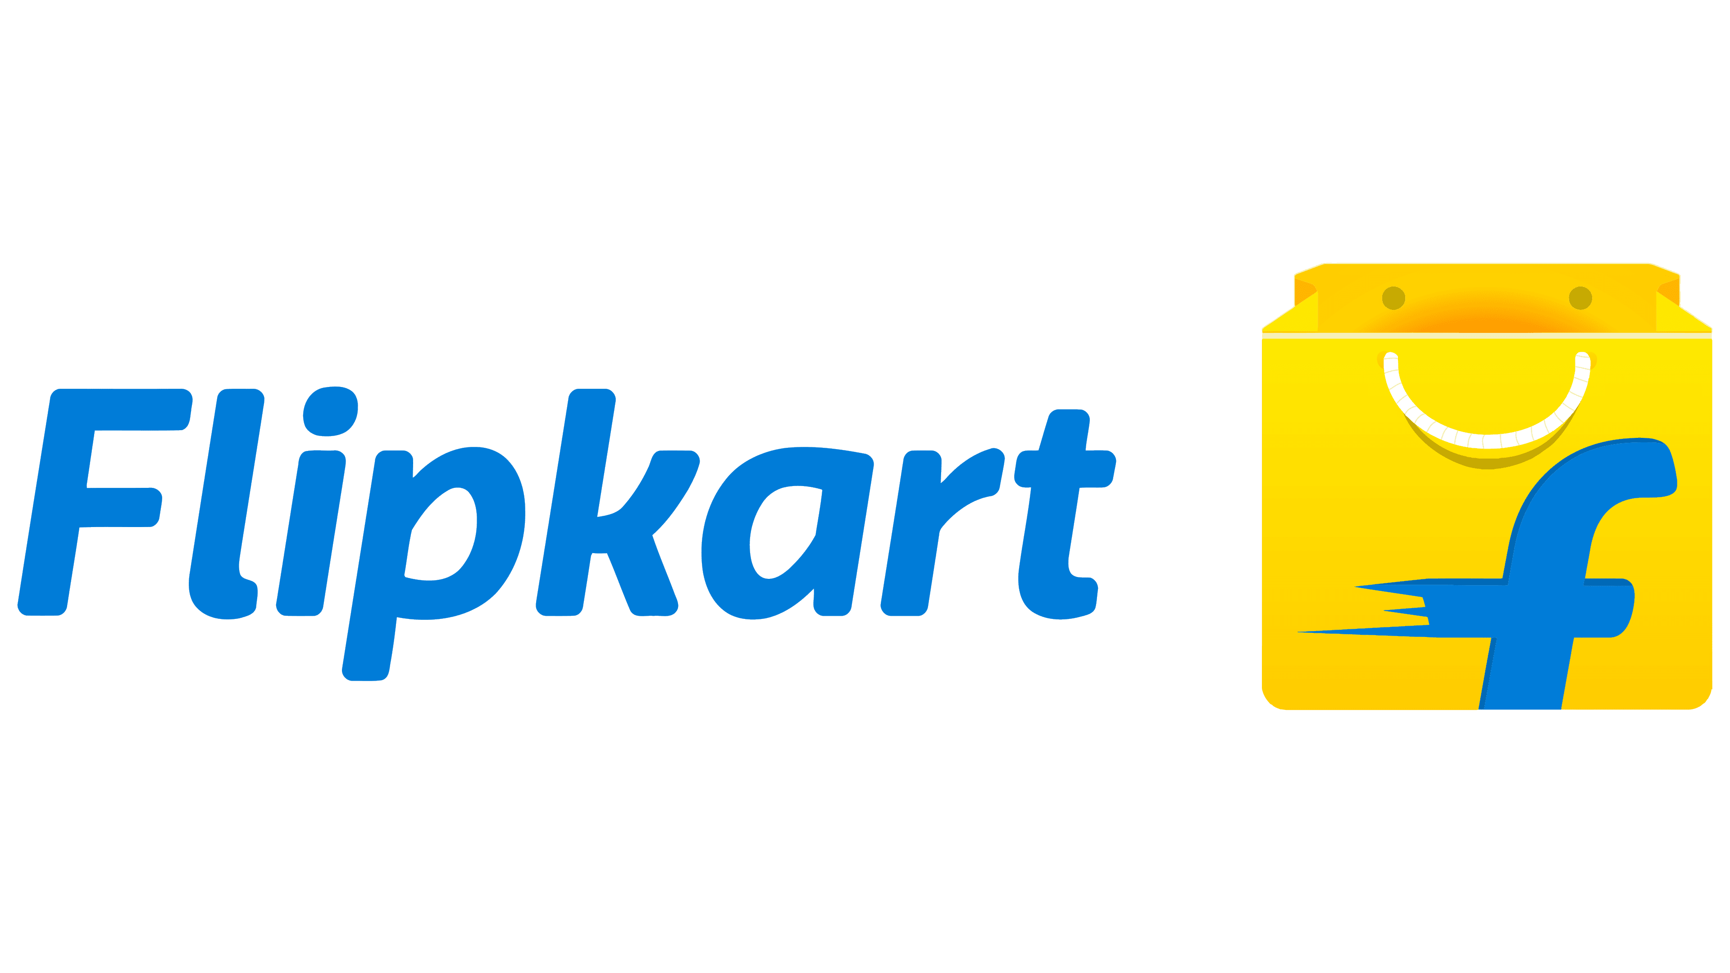


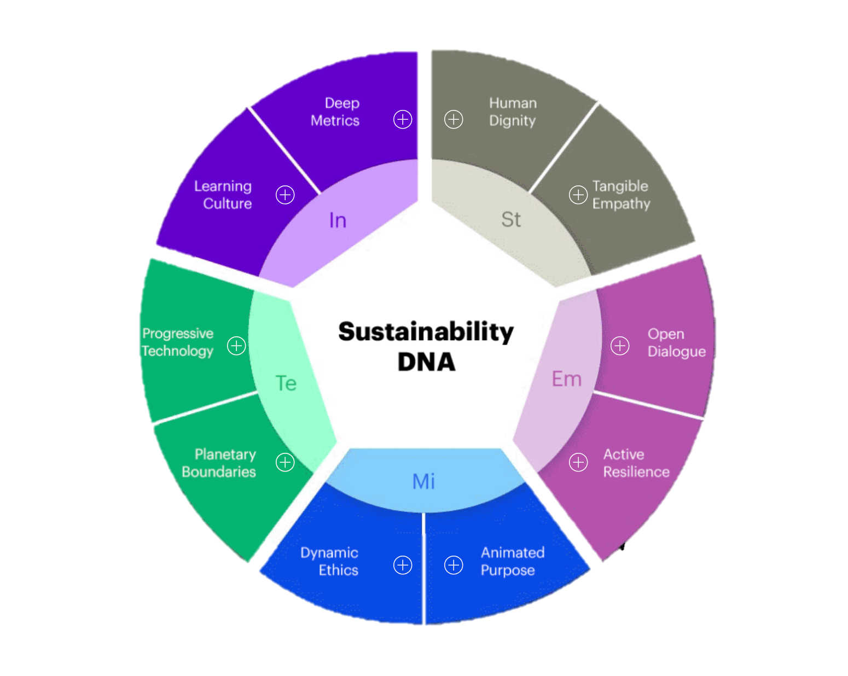



Redefining last-mile delivery with a P2P social ecosystem approach
Who could be a buddy?
A P2P network to enforce social conscientiousness
How do we onboard & track our buddies?
T1-T2 resident
350 Mn
SAM
20 Mn buddies
by 2030
Digital commerce player to offer incentives against EcoPoints
Interest
Onboard & info-capture
E-Commerce players
Check
15-60 yrs
200 Mn
Real-time, GPS tracking
Office-goers
60 Mn
Track
Select
360 deg buddy feedback
Freq. travelers
1 Mn
Train
KPIs (eg % acc. delivery)
The Buddy Cycle
track/modify each order from multiple platforms (app/website redirection)
Sustainability is in the ecosystem’s DNA
Acquire
Engage
Retain
Add/modify/delete buddies in your network . Compete with your buddies on sustainability & rewards
Sustainability DNA assessment shows that the P2P ecosystem furthers a sustainable supply chain effort
In-App trigger, SM marketing,
personalization
E-comm, direct & social media messaging
Rewards via EcoPoints, tie into other SM
Trigger: Become a buddy to gain social, economic, environmental stewardship and gain social media recognition
Buddy Value Proposition
Ability to have your buddy pick up your order and share the reward!
Environmental: ESG Champion
Tangible Empathy: Flexibility along the SC allows scope for variability
Social: Validation from peer-set
Open Dialogue: Transparent comm. amongst all stakeholders for dynamic alloc.
Economic: Additional revenue stream
Tenets of the buddy-driven ecosystem
Animated Purpose: Aggregation of ecomm players in a novel P2P ecosystem
Building buddy incentives
City
Location
Commission Metrics
Accessibility
Transparency
Security
Tier 1
Offices
ESG Score - EcoPoints
Providing maximum visibility & ownership of delivery channels to the consumer
Introducing trust as the core driver for ecosystem scalability
Planetary Considerations: Significant carbon emission, traffic reduction with P2P
Metro Stn
-
Aggregation of multiple ecomm players through an intuitive UI format
Societies
Peer network scale
% of dist. cost
Deep Metrics: Impact tracking across decarbonization levers
Tier 2
Kirana
Industry Analysis
Total SC Reinvention
Transportation
Transportation
Distribution
Distribution
Redefining P2P Ecosystem
Win Win Win

Slide 7

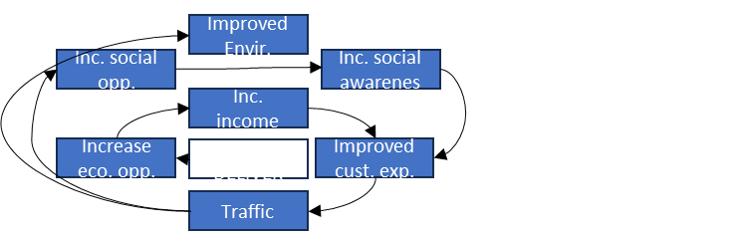





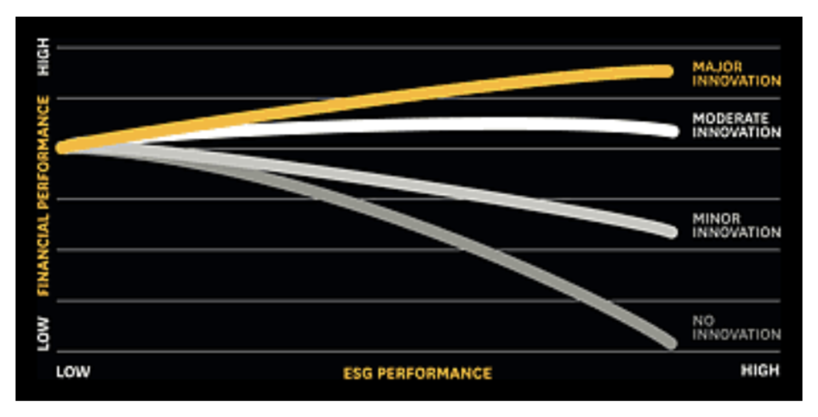




2-pronged approach for growth strategy involves defining the winning industry standards and expanding the horizontal and vertical boundaries
Winning the industry standard
Win through growth potential
Thank You
1
2
3
Tech Diffusion
Org Linkage
Penetrate
1. Full potential from core
Open-source routing model and P2P network
Protect IP, but empower innovation ecosystem
Promote load sharing amongst peerset with open-source model to establish standard
Linkages with ecomm players to inc. avail. of complementary goods
Aggressive promotion to increase installed base and improve likelihood of winning standards battle
Single point of aggregation from multiple firms with shared delivery routes & fulfilling together
Kripi Badonia +91 88000 97307 PGP38453@iiml.ac.in
Kritika Prakash +91 98719 31051 PGP38347@iiml.ac.in
Shivam Pathak +91 80738 00369 ABM19021@iiml.ac.in
Manav Sehgal +91 98183 11969 PGP39088@iiml.ac.in
2. Horizontal Adjacencies in the ecosystem
4
Winning the virtuous cycle
Priority opportunities for horizontal expansion
A
B
C
Grocery Retail
Pharma
Auto component
3. Ecosystem vertical Integration for EVP
Anchor industry
& clients
VC Nodes
Breaking the performance frontier
The modelled 4-step process will put client on peak performance trajectory enabling Ecodeliver to break the industry frontier and win in this market
Pricing model
Tech Stack
Right assets & infra
Organization & Capability

